Slide 1
TH
THEMATIC MAPPING

Slide 2
A thematic map is a type of map specifically designed to show a
Particular theme connected with a specific geographic area, such
as temperature variation, rainfall distribution or population density.
- wikipedia
When creating a thematic map, it is important that we fully understand
the data we are planning to depict and the consequence of representing
this data incorrectly. Maps can sometimes be used to misinform so
choosing the correct map technique is crucial.

Slide 3
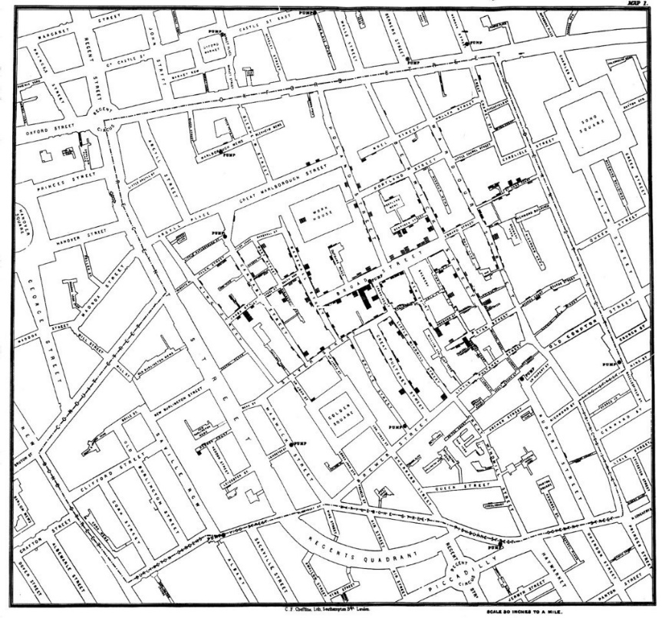
DOT DENSITY MAP
A dot density map is a map that uses a dot symbol to represent a feature.
One-to-one
Each dot is equally sized and represents the recording of a single thing. Each dot should be depicted in its correct spatial location.
One-to-many
Each dot depicts more than one recording of a thing and is determined by the cartographer. Dots can be randomly positioned and do not necessarily represent the spatial location of something.
This method was used to great effect in the 19th century when English physician John Snow, mapped the location of cholera outbreaks.
Rather than a point, John Snow mapped each case with a bar and in doing so he was able to connect the source of the outbreak to a nearby water pump.

Slide 4
DOT DENSITY MAP
ADVANTAGES
You can map raw data/simple counts, e.g. number of GP surgeries.
Work in black and white.
Shows density and distribution across a wide area.
Gives a good visual representation of variations across the data.
DISADVANTAGES
Clustering can make data difficult to interpret.
Areas with no dots give a false sense of emptiness (no population).
Geography can become hidden.
Dots on a one-to-many can be inferred as a single location of something.
Not great for retrieving actual rates or numbers.

Slide 5
PROPORTIONAL SYMBOL MAP
A proportional symbol map uses map symbols that vary in size to represent a numeric variable.
For example, circles may be used to show the location of cities where each circle is sized proportional to the population of the city.
Both of these maps depict coronavirus cases in the UK using two different proportional symbol mapping techniques.
The first map uses circles sized by the amount of cases. The larger the circle, the more cases present.
The second map uses ridges which have been heighted by the amount of cases. The higher the ridge, the more cases present. The locations with higher cases have been annotated with their exact number too.
Sam Joiner, Head of Data at the Times.

Slide 6
PROPORTIONAL SYMBOL MAP
ADVANTAGES
Large quantities of data can be interpreted quickly.
Useful for visualising differences between many places.
Easier to extract actual numbers.
Can use raw data (totals or counts) and standardised data (ratios or percentages).
Smaller geographic regions are not overlooked.
DISADVANTAGES
As values get bigger, symbols can begin to overlap.
Size of symbols can obscure location.
Map readers do not always estimate area of symbol well.

Slide 7
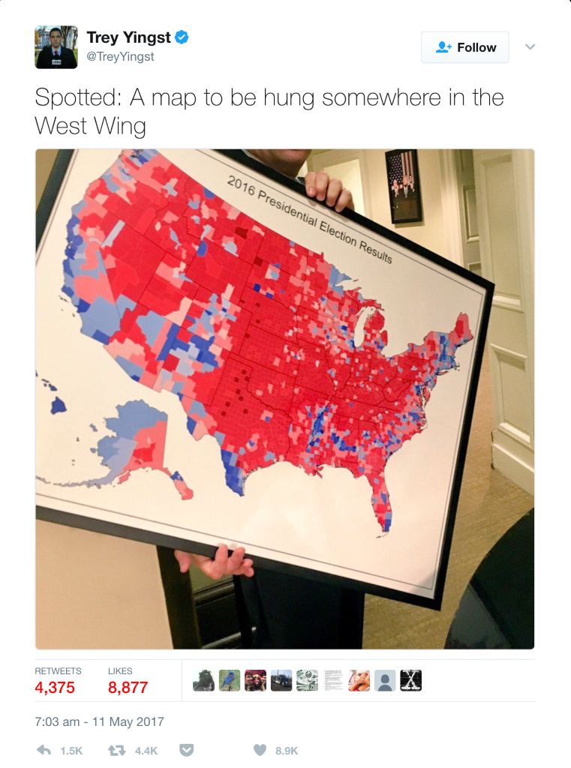
CHOROPLETH MAP
A choropleth map is a map where geographic areas are coloured or styled in relation to a value.
This technique is useful when visualising how a measurement varies across a geographic area and is commonly used when looking at vote totals by a political party.
You should never use a choropleth map for raw data and instead should normalise or standardise your data to show rates or ratios.
Donald Trump famously shared a choropleth map with reporters in 2016 that depicted the results of the 2016 election.
The map was very clear in showing that Donald Trump won more land mass than Hilary Clinton. However a lot of those red counties have tiny populations which is something the map does not tell you.
A different thematic technique would have painted a very different picture if you allow for actual population of each county.

Slide 8
CHOROPLETH MAP
ADVANTAGES
Easy to understand.
Depicts spatial distributions of data really well.
Works at virtually all scales.
DISADVANTAGES
May not work in black and white.
Map assumes the region/area has the same value. Normalise.
Smaller regions/areas can get easily overlooked.
Not suitable for raw data.

Slide 9
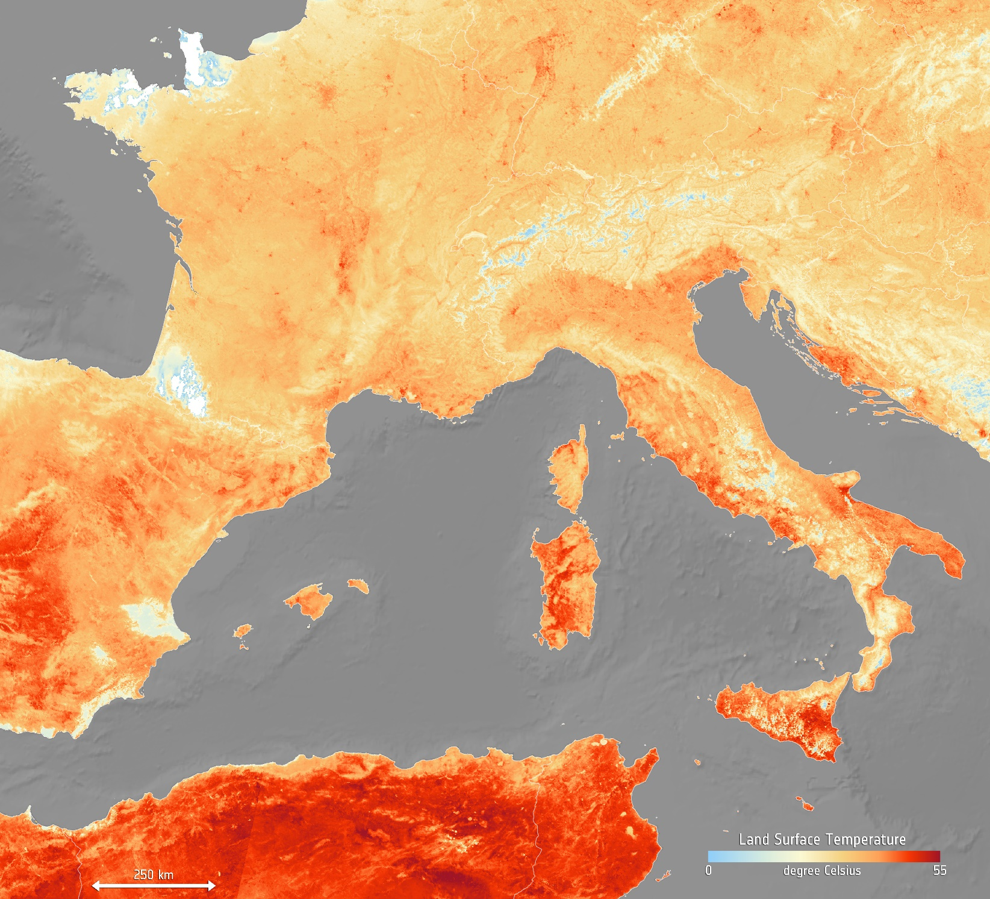
HEAT MAP
A heat map is used to represent the density of data in gradients of colour.
A heat map is a favourite among many and is used to represent the density of data in gradients of colour.
They are typically used to depict things like crime hot spots or temperature.
This heat map shows the temperature of the land and has been generated using information from the Copernicus Sentinel-3’s Sea and Land Surface Temperature Radiometer. The map is easy to interpret and quickly shows the difference in land temperature across some European land mass.
When using 3rd party data it’s important that your source is accurate and trustworthy and that you understand what the data is telling you.
If you don’t, then your map may misinform and your message lost.
Contains modified Copernicus Sentinel data 2019 / CC BY-SA 3.0-IGO (https://creativecommons.org/licenses/by-sa/3.0-igo).

Slide 10
HEAT MAP
ADVANTAGES
Hot spots in data can be quickly identified and analysed further.
Works well when using temperature or pollution data.
Allows you to quickly identify areas for further analysis.
DISADVANTAGES
Excessive use of colour can affect the legibility of the map.
Overused.
Does not depict data distribution well.

Slide 11
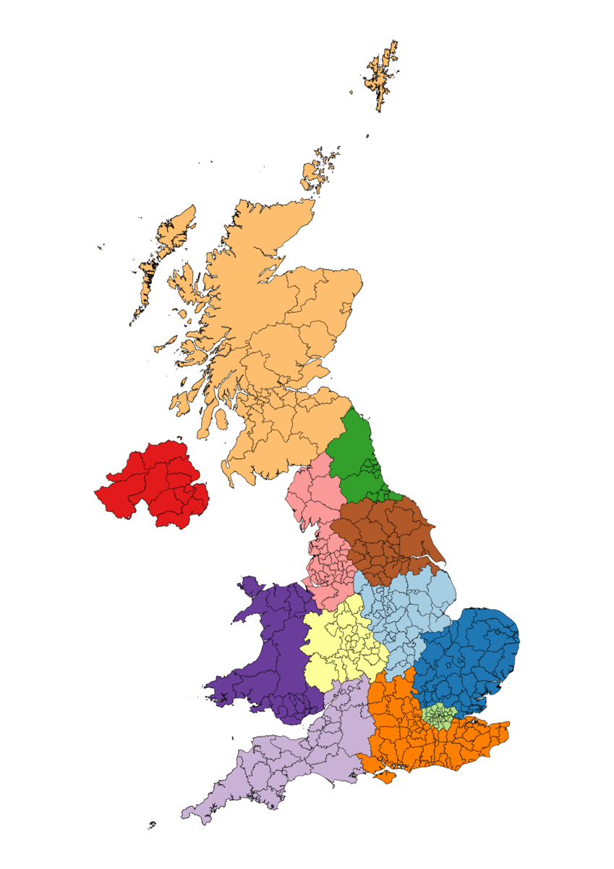
EQUAL AREA CARTOGRAMS
Cartograms use geographic shapes (e.g. countries) to size regions based on a data value.
Equal Area Cartograms use the same size shape while preserving all the other aspects associated with cartograms.
The spatial relationship should remain as close as possible.
If you’d like to have a go at creating your own Equal Area Cartogram then Ordnance Survey have released their own hand-designed equal area cartograms for geographies of Great Britain (GB) and the United Kingdom (UK).
This currently provides one cartogram for local authority district (LAD) geography. These can be found at-
github.com/OrdnanceSurvey/equal-area-cartogram

Slide 12
EQUAL AREA CARTOGRAMS
ADVANTAGES
Visually appealing.
Further datasets can be depicted.
Regions/areas are all the same size.
Each region can be labelled the same.
No risk of regions getting lost.
DISADVANTAGES
The location is not always 100% accurate

Slide 13
TH
The information provided in this document is for guidance only and should not be regarded as definitive in any way. The British Cartographic Society can not be held liable for the way information provided is used in any form of publication. If you are uncertain you should always seek independent professional advice.
Copyright British Cartographic Society 2020, Registered Charity No. 240034

